Slide 1
Chapter - 7
Javascript And Xhtml Documents

Slide 2
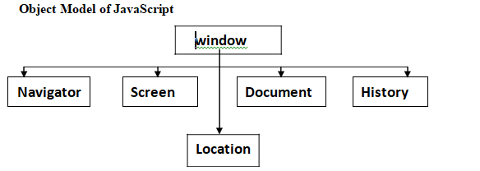
Javascript Execution Environment
Window Object:
The Window object is at the Top level in the JavaScript hierarchy.
It represents the Window that Displays the XHTML document.

Slide 3
Object Name | Use
Navigator | The Navigator object is used to get some important and useful information about visitor’s browser and system like name of the browser, version of the browser, the platform on which the client is working, language and so on.
Document | To access the document currently loaded in a window.(executing)
Screen | Contains information about the visitor's screen. What all information's are there in the users screen.
Location | Contains Information about the URL of the current window.
history | To maintain a history of the URLs previously accessed within a window

Slide 4
**Properties and Methods of Window Object:
Name- used to name the window
Location- Gives the URL of the current window
Alert () – Creates a rectangular dialogue box with a message. It displays an alert box with a message and an OK button
Confirm()- Which will create dialogue box for users confirmation. Displays a dialog box with a message and an OK and a Cancel button
Focus() – It is used to Set focus to the current window.
JavaScript focus method is used to give focus to a html element. It sets the element as the active element in the current document
Blur()- Removes focus from the current window
Open()- used to open a new window
Close ()- used to close a window which is open

Slide 5
**DOM- Document Object Model
The DOM represents a document as a hierarchical tree of nodes, allowing developers to add, remove, and modify individual parts of the web page.
The Document Object Model is an Application Programming Interface (API) for HTML documents.
An API is a set of programming code that enables data transmission between one element and another. It also contains the terms of this data exchange.

Slide 6
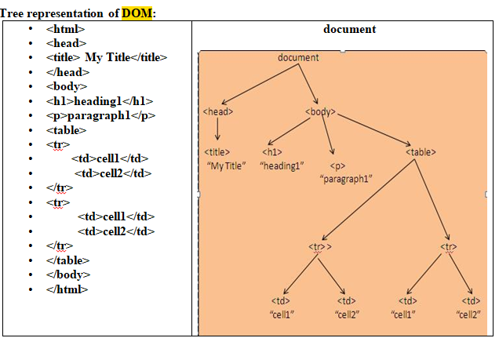

Slide 7
Levels of DOM:
DOM 0:
This is the oldest DOM.
Introduced by Netscape.
supported by all JavaScript-enabled browsers (no written specification)
Gives easy access to forms and their elements, images and links.

Slide 8
DOM1
-The Initial DOM Standard is known as DOM Level 1.
- Introduced by W3C.
- it supports both HTML and XML documents
- accepts changes in portion of the document.

Slide 9
DOM 2:
-Advanced version of DOM 1.
-DOM 2 is the latest approved standard
– support for namespaces(Organizes JS Coding)
– It supports Style sheets.

Slide 10
DOM 3:
-Latest version recommended in 2004.
– support for namespaces(Organizes JS Coding)
– It is intended to resolve a lot of complications that exists in level 2 DOM.
- It supports DTD,CSS and other features.
- Very few browsers will support DOM 3

Slide 11
*Element Access in JavaScript
The form elements in JavaScript can be accessed in 3 different ways:
Using forms and elements arrays of document object.
Using form names.
Using getElementById () method.

Slide 12
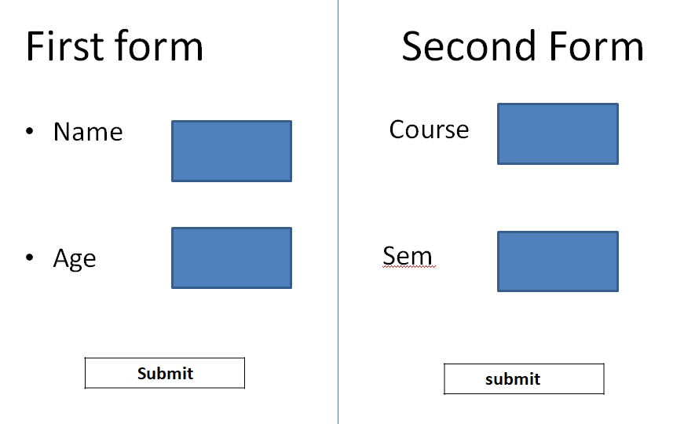

Slide 13
The script will be as follows
First form
<form name=“first form”>
<input type=“text” name=“Name”>
<input type =“text” name= “Age”>
<input type =“Submit” name= “Submit”>

Slide 14
Second form
<form name=“Second form”>
<input type=“text” name=“Course”>
<input type =“text” name= “Sem”>
<input type =“Submit” name= “Submit”>

Slide 15
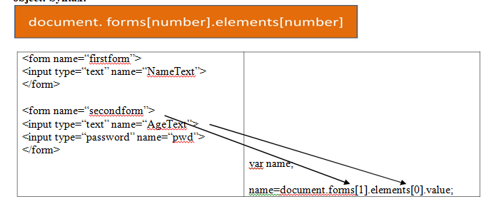
Accessing elements of the form using forms and elements arrays
First form
document.forms[0].Name[0];
document.forms[0].Age[1];
document.forms[0].Submit[2];
Second Form
document.forms[1].Course[0];
document.forms[1].Sem[1];
document.forms[1].Submit[2];

Slide 16
Accessing elements of the form using form names.
Using the Name attribute the elements can be accessed using the syntax:
The same form First form can be accessed as follows:
document.firstform.Nametext;
document.firstform.Agetext;
document.firstform.Submit;
Similarly second form can be accessed as:
document.secondform.Coursetext;
----------------------------------

Slide 17
Accessing elements of the form using getElementById
document.getElementById(“Name”);
document.getElementById(“Age”);
document.getElementById(“Submit”);

Slide 18
*Events and Event Handling
An event is a notification that something specific has occurred, either with the browser or an action of the user.ie the occurrence of something is an event.
An event is invoked when a user has done a specific action.
An event handler is a software routine that provides the processing for various events.
The process of connecting an event handler to a event is called registration.

Slide 19
*Different ways of registering an event
Assigning an event handler script to an event tag attribute.
Ex: <a href=“book.html” onClick=“alert(‘hello’)”>
If we want more than one statement to be executed when an event occurs we can use functions.
Ex: < input type=“click” onClick=“MyFunction()”>
By assigning the associated event property on the button object.
Ex:
document.getElementById(“MyButton”).onclick=Myfunction();

Slide 20
*Types of Events
User Interface Events
Mouse Events
Form events
Key Events
XHTML events
Window / doument events

Slide 21
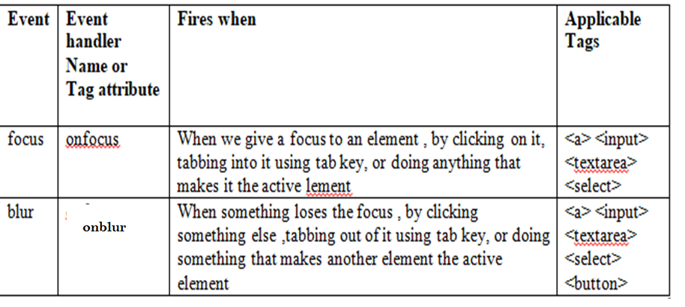
User Interface Events
Events which are invoked by user is called UI Events.

Slide 22
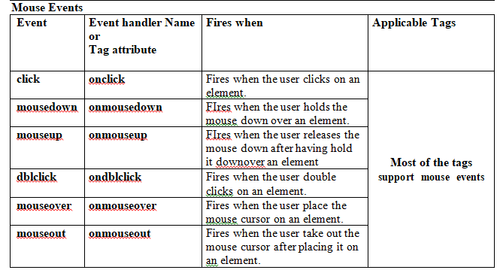
*Mouse Events
Events that invoked with mouse is called mouse events.

Slide 23
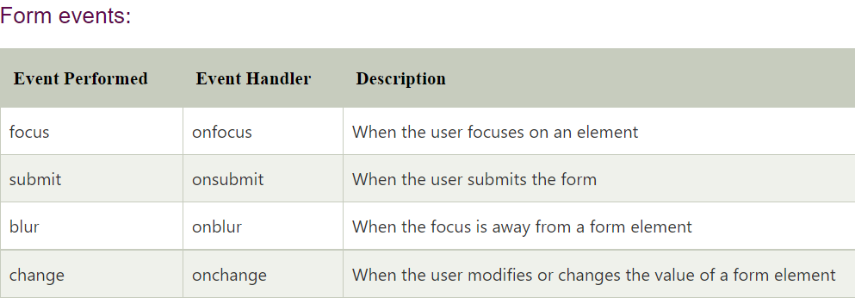

Slide 24
*Key Events
Events invoked using Keyboard is called Keyboard events.
Keydown-onkeydown
Keypress- onkeypress – enables when the user press a key for some action.
Keyup- onkeyup

Slide 25
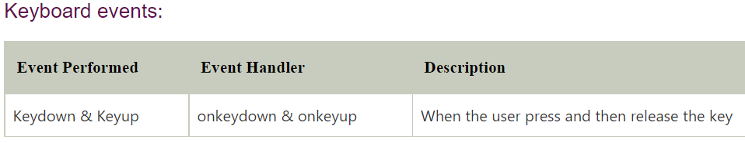
It can be applied inside the <body> and form elements

Slide 26
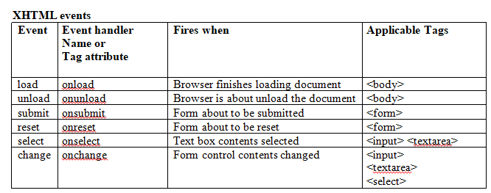
XHTML Events
Events that do not belongs to Keyboard or mouse is called XHTML events

Slide 27
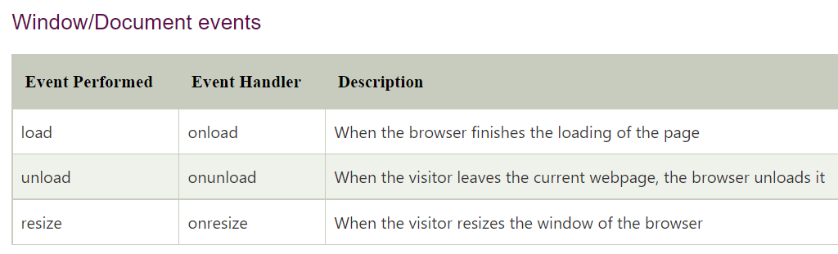

Slide 28
The DOM 2 Event Model
The DOM2 Events specification was released by W3C in November 2000.
It provides an advanced standards for event handling.
It provides a way to control different events in a web page.

Slide 29
The DOM2 level model added several important features to the existing DOM 0 level event model.
It Introduced a way to set several handlers for a specific event;
Introduced the notion of event flow with event captures and event bubbling.
Introduced Event Propagation.

Slide 30
*Event propagation
The property of travelling of an event from one element to another element throughout the document.
The DOMhas 2 ways for objects to detect events :
→From the top down(event capture)
→From the bottom up(event bubbling)
The node of the document tree where the events created is called the target node.

Slide 31
Event Capture
In this method of detecting the events, a top – down approach is used for capturing the events.
In this phase the event starts at the root node in the document and propagates towards the target node.
In this travelling if any event handler is found then checks if they are enabled or not.
If they are enabled then it is executed first by the capturing phase and finally reaches to the target node (<img> )and execute the handler code.

Slide 32
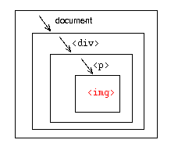

Slide 33
Event Bubbling
In this method of detecting the events it uses the bottom – up approach.
Event starts at target node and executes the handler code registered to the target node and moves upwards to the document tree.
And the event just rises like a bubble in a glass of water.
In the process if any other node has handler code, it will execute.
Finally reaches the root node.<document>

Slide 34
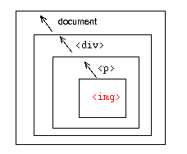

Slide 35
*DOM Tree Traversing
Traversing, which means "move through", are used to "find" (or select) HTML elements based on their relation to other elements.
Start with one selection and move through that selection until you reach the elements you desire.
The image below shows an HTML page as a tree (DOM tree). With DOM traversing, you can easily move up (ancestors), down (descendants) and sideways (siblings) in the tree, starting from the selected (current) element. This movement is called traversing - or moving through - the DOM tree.

Slide 36
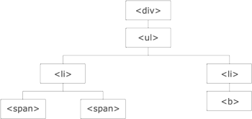
The <div> element is the parent of <ul>, and an ancestor of every other tag inside of it
The <ul> element is the parent of both <li> elements, and a child of <div>
The left <li> element is the parent of <span>, child of <ul> and a descendant of <div>
The <span> element is a child of the left <li> and a descendant of <ul> and <div>
The two <li> elements are siblings (they share the same parent)
The right <li> element is the parent of <b>, child of <ul> and a descendant of <div>
The <b> element is a child of the right <li> and a descendant of <ul> and <div>

